Slide 1
Hotel booking analysis
CAPSTONE PROJECT
Presented By:
R.V.THENMOZHI
SHANMUGANATHAN ENGINEERING COLLEGE
CIVIL DEPARTMENT

Slide 2
OUTLINE
Problem Statement
Proposed System/Solution
System Development Approach
Algorithm & Deployment
Result
Conclusion
Future Scope
References

Slide 3
Problem Statement
In this project I am going to analyze Hotel Booking data set.
This data set contains information of city hotel and resort hotel, and includes information of booking time, length of stay, number of adults, children and /or babies, also have information of available parking space, among other thing.
The objective of this project is explore and analyze the data to discover important factors that govern the booking.

Slide 4
Proposed Solution
Utilizing advanced machine learning algorithms, our solution will analyze extensive historical hotel booking data to establish patterns and correlations
For optimal timing, a predictive model will consider factors such as length of stay, seasonality, demand fluctuations and promotional periods, providing users with insights on when to secure the most cost- effective room rates.
It enhance customer satisfaction

Slide 5
System Approach
System Requirements:
Hardware:
A computer with sufficient processing power, preferably with multiple cores or a GPU for faster training of machine learning models.
Adequate RAM to handle the size of the dataset and computational requirements.
2. Software:
An operating system compatible with the required machine learning libraries (e.g., Windows, Linux, macOS)
3. Library requirements:
Pandas
NumPy
Matplotlib
Seaborn

Slide 6
Algorithm & Deployment
Algorithm selection:
Data Exploration: Explore the hotel booking dataset’s structure, features, and target variables(s). Identify potential patterns, correlations and outliers.
Problem Formulation: Define the problem: Predict optimal booking times, ideal length of stay, number of adults, children and /or babies, also have information of available parking space, among other thing based on historical data
Algorithm selection : Regression tasks , Consider linear regression, decision trees, or ensemble methods, Classification tasks , Consider logistic regression, decision trees, random forests.

Slide 7
Algorithm & Deployment
Data input:
Data collection: Gather historical hotel booking data, including information on booking dates, length of stay, number of adults, children and /or babies, also have information of available parking space, among other thing
Data Cleaning: Handle missing values, outliers, and any inconsistencies in the dataset. Convert categorical variables into numerical representations through encoding techniques
Feature Engineering: Create new features or modify existing ones based on domain knowledge. Extract meaningful information from date variables, such as day-of- week or month.

Slide 8
Algorithm & Deployment
Training process:
Data Splitting: Divide the dataset into training and testing sets to evaluate the model’s performance and Standardize or normalize numerical features to ensure they have a consistent scale.
Model training : Use the selected algorithm to train the model on the training data set and adjust hyperparameters to optimize model performance
Model evaluation: Evaluate the model on the testing dataset using appropriate metrics(e.g., Mean Squared Error for regression, accuracy, precision, recall for classification).

Slide 9
Algorithm & Deployment
Prediction Process:
New data input : Collect new data or use existing data to make predictions
Preprocessing: Apply the same data preprocessing steps ( cleaning, feature engineering, scaling) to the new data.
Model Inference : Use the trained model to make predictions on the new data
Results Interpretation: Interpret the model’s predictions in the context of the problem at hand. For regression, interpret the predicted values as optimal rates or lengths of stay. For classification, interpret predictions as the likelihood of special requests.

Slide 10
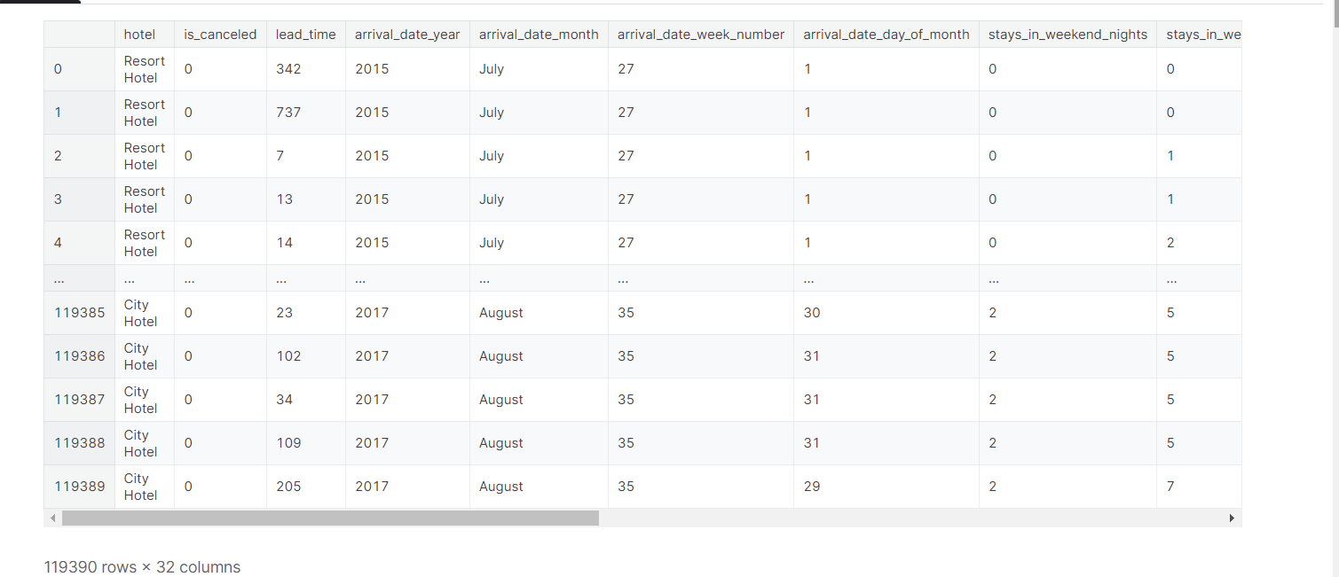
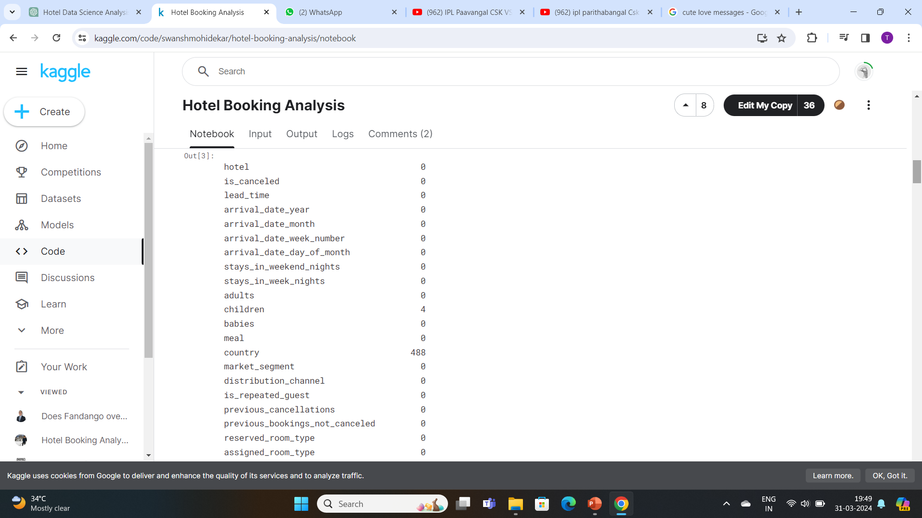
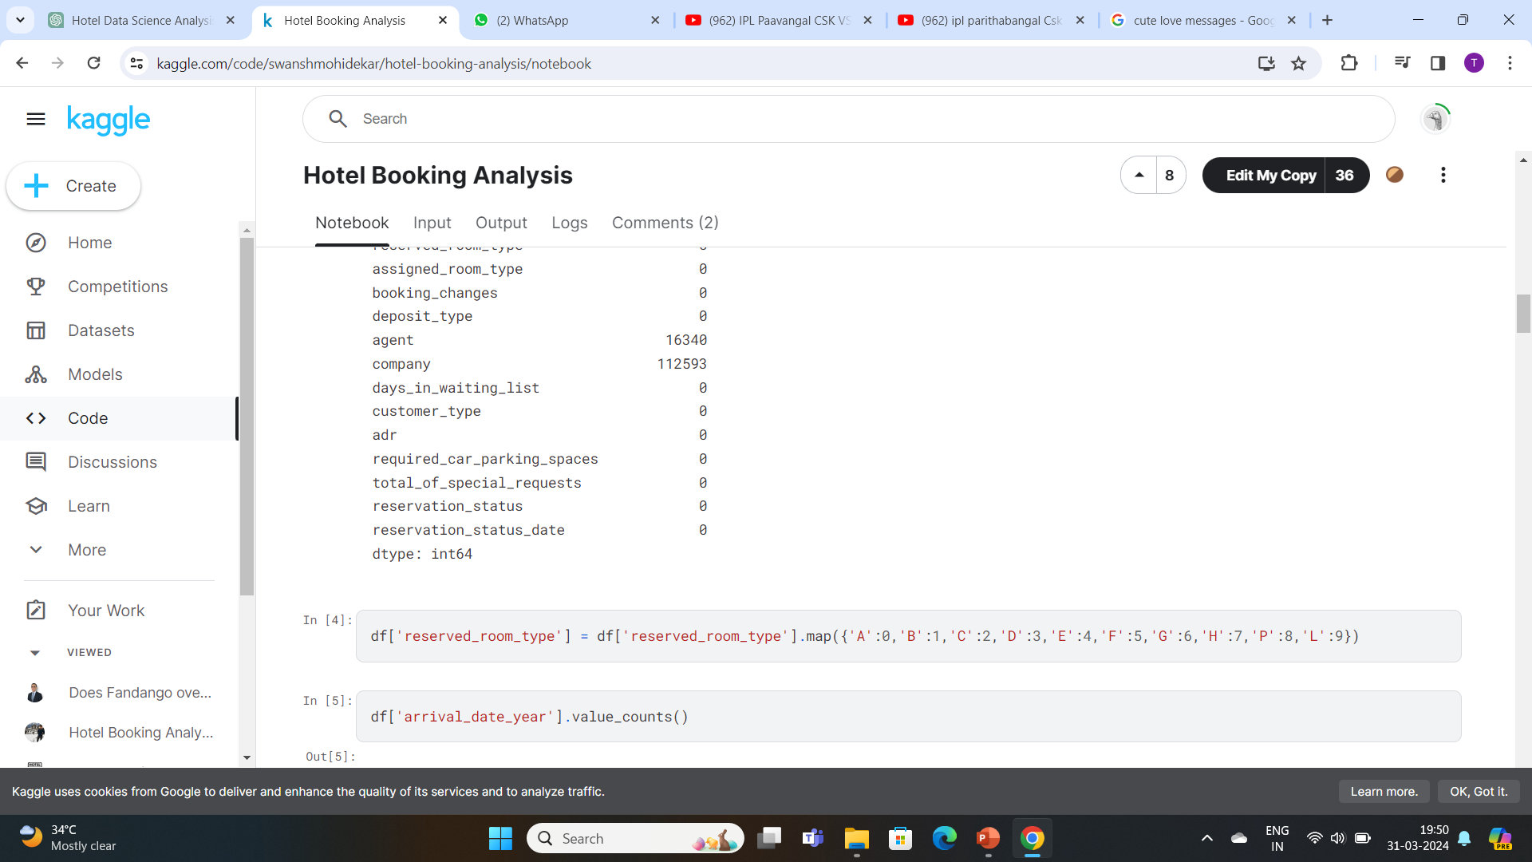
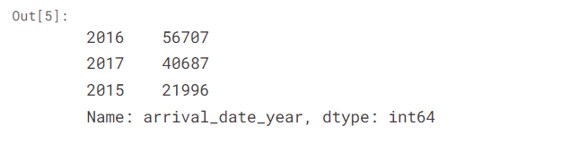
Result

Slide 11
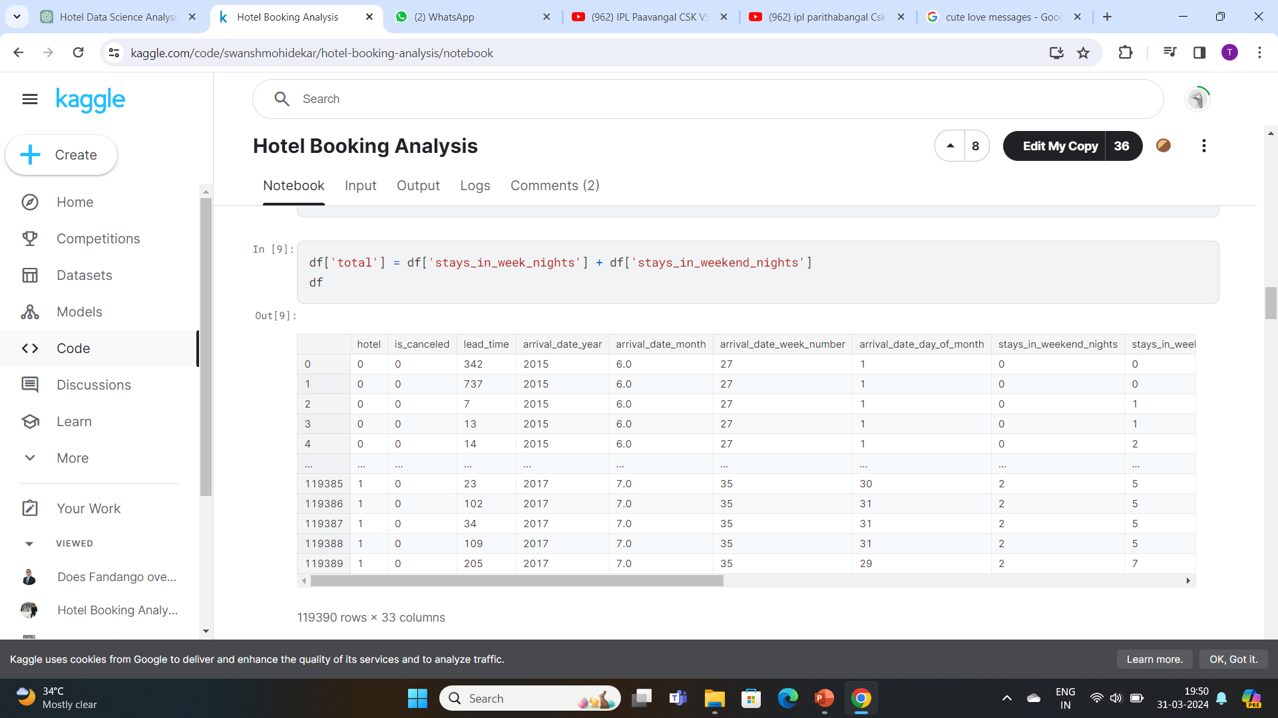
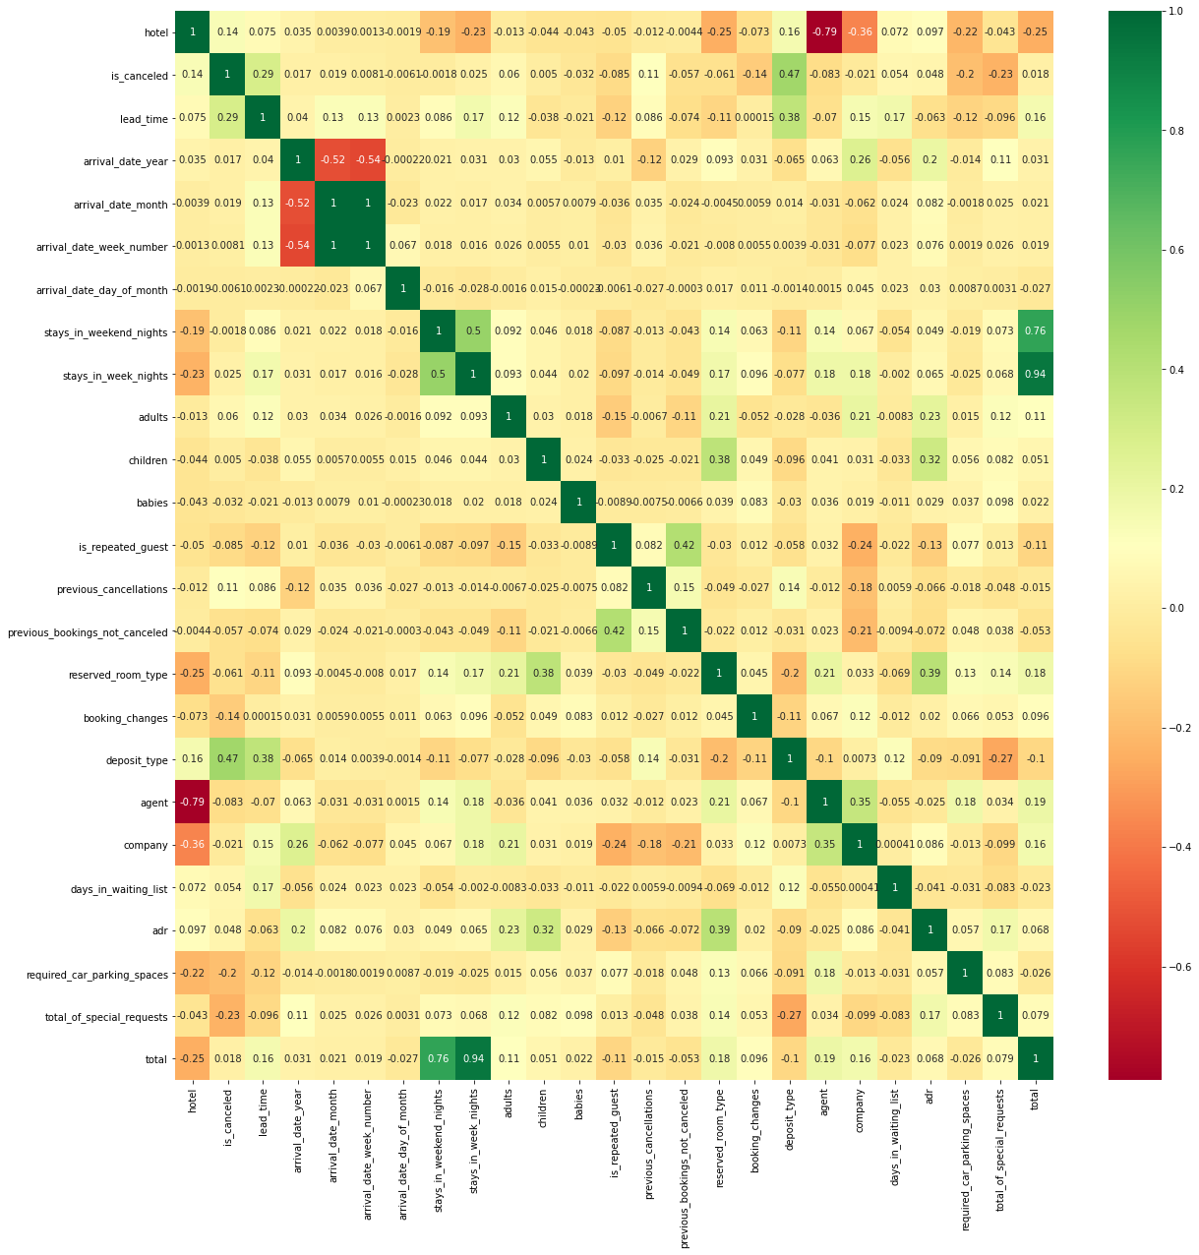
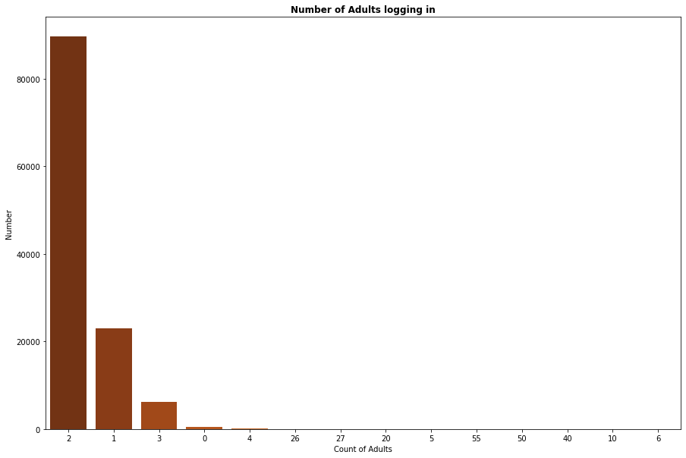
Result

Slide 12
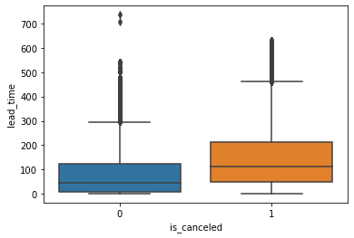
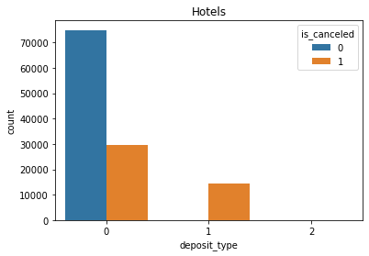
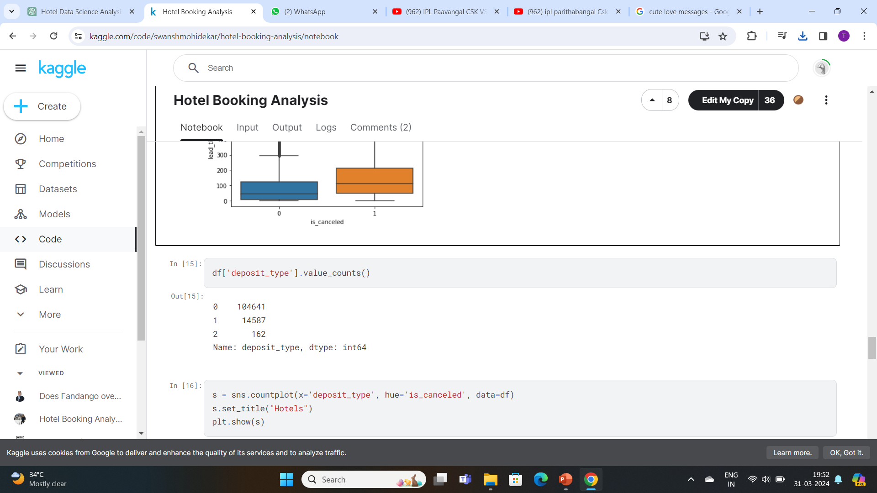
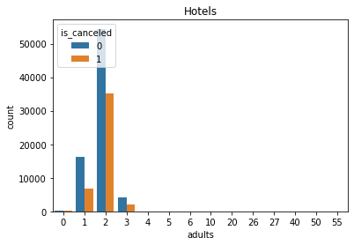
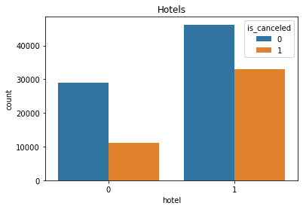
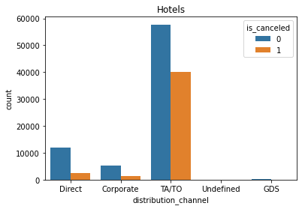
Result

Slide 13
Conclusion
By using innovative machine learning methods, our suggested solution can dynamically and optimally improve the hotel reservation process.
Through a rigorous analysis of vast amounts of historical booking data, we are able to identify patterns and correlations that are essential for tackling major issues that both travellers and hoteliers encounter.

Slide 14
Future scope
Here are key areas for future exploration and enhancement
Predictive personalization
Real-time Dynamic Pricing
Blockchain for Transparency and security
Predictive maintenance and Asset management
IoT and smart Hotels

Slide 15
References
https://www.Kaggle.com/datasets
https://seaborn.pydata.org/
https://matplotlib.org/stable/contents.html
https://pandas.pydata.org/pandas-docs/stable/user_guide/index.html

Slide 16
THANK YOU

